Slide 1

Data Platform -Business Partner
Evaluation Session
06 Oct 2025
Pham Thanh Tung Chuyên viên tungpt.pt8@shb.com.vn

Slide 2
Architecture Review

Slide 3

Architecture Review
Data Lakehouse
Data Consumption
Data Warehouse
Structured Data Source
Structured Data Source
Structured Data Source
Data & AI Management
Data Organization
Data Integration
Notes:
1 hiện trạng
2 sizing
3 tiếp cận triển khai

Slide 4
Architecture Review
Data Lakehouse
Data Consumption
Data Warehouse
Data Lake / GenAI DataStore
Structured Data Source
Structured Data Source
Structured Data Source
Un-Structured Data Source
Un-Structured Data Source
Un-Structured Data Source
Object Store / File Store
Data & AI Management
Data Organization
Data Integration
Notes:
1 hiện trạng
2 sizing
3 tiếp cận triển khai

Slide 5
Architecture Review
Data Lakehouse
Data Consumption
Data Virtualization / Data Federation / Query Engine
Data Warehouse
Data Lake / GenAI DataStore
Structured Data Source
Structured Data Source
Structured Data Source
Un-Structured Data Source
Un-Structured Data Source
Un-Structured Data Source
Object Store / File Store
Data & AI Management
Data Organization
Data Integration
Notes:
1 hiện trạng
2 sizing
3 tiếp cận triển khai

Slide 6
Architecture Review
Data Lakehouse
Data Consumption
Data Management
Data Virtualization / Data Federation / Query Engine
Metadata Management
Data Lineage
Data Quality
Data Warehouse
Data Lake / GenAI DataStore
Data Reference Management
Data Protection Rule
Master Data Management
Structured Data Source
Structured Data Source
Structured Data Source
Un-Structured Data Source
Un-Structured Data Source
Un-Structured Data Source
Object Store / File Store
Data & AI Management
Data Organization
Data Integration
Notes:
1 hiện trạng
2 sizing
3 tiếp cận triển khai

Slide 7
Architecture Review
Data Lakehouse
Data Consumption
AI Governance
Advanced Analytic
AI/ML/Agentic AI
BI Report
Adhoc-Query
Data Consumption
AI/Agent/MLOps
AI/ML Lifecycle Manage
GRC
Data Virtualization / Data Federation / Query Engine
Data Management
Metadata Management
Data Lineage
Data Warehouse
Data Lake / GenAI DataStore
Data Quality
Data Reference Management
Data Protection Rule
Structured Data Source
Structured Data Source
Structured Data Source
Un-Structured Data Source
Un-Structured Data Source
Un-Structured Data Source
Master Data Management
Object Store / File Store
Data & AI Management
Data Organization
Data Integration
Notes:
1 hiện trạng
2 sizing
3 tiếp cận triển khai

Slide 8
Architecture Review
Data Lakehouse
AI Governance
Advanced Analytic
AI/ML/Agentic AI
BI Report
Adhoc-Query
Data Consumption
AI/Agent/MLOps
AI/ML Lifecycle Manage
GRC
Data Virtualization / Data Federation / Query Engine
Data Process
Data Observability
Data Management
Metadata Management
Data Lineage
Data Warehouse
Data Lake / GenAI DataStore
Data Quality
Data Reference Management
Data Protection Rule
Structured Data Source
Structured Data Source
Structured Data Source
Un-Structured Data Source
Un-Structured Data Source
Un-Structured Data Source
Master Data Management
Object Store / File Store
Data & AI Management
Data Organization
Notes:
1 hiện trạng
2 sizing
3 tiếp cận triển khai

Slide 9

Architecture Review
Data Lakehouse
Data Consumer
Self Service
Discover Data
Trust Data
Understand Data
Data Privacy
AI Governance
Advanced Analytic
AI/ML/Agentic AI
BI Report
Adhoc-Query
Data Consumption
AI/Agent/MLOps
AI/ML Lifecycle Manage
GRC
Data Virtualization / Data Federation / Query Engine
Data Process
Data Observability
Data Management
Metadata Management
Data Lineage
Data Warehouse
Data Lake / GenAI DataStore
Data Quality
Data Reference Management
Data Protection Rule
Structured Data Source
Structured Data Source
Structured Data Source
Un-Structured Data Source
Un-Structured Data Source
Un-Structured Data Source
Master Data Management
Object Store / File Store
Data & AI Management
Data Organization
Data Integration
Notes:
1 hiện trạng
2 sizing
3 tiếp cận triển khai

Slide 10

Architecture Review
Data Lakehouse
Data Consumer
Data Producer
Self Service
Discover Data
Trust Data
Understand Data
Data Privacy
Self Service
Share Data
Update Data
Package Data
Data Privacy
AI Governance
Advanced Analytic
AI/ML/Agentic AI
BI Report
Adhoc-Query
Data Consumption
AI/Agent/MLOps
AI/ML Lifecycle Manage
GRC
Data Virtualization / Data Federation / Query Engine
Data Process
Data Observability
Data Management
Metadata Management
Data Lineage
Data Warehouse
Data Lake / GenAI DataStore
Data Quality
Data Reference Management
Data Protection Rule
Structured Data Source
Structured Data Source
Structured Data Source
Un-Structured Data Source
Un-Structured Data Source
Un-Structured Data Source
Master Data Management
Object Store / File Store
Data & AI Management
Data Organization
Data Integration
Notes:
1 hiện trạng
2 sizing
3 tiếp cận triển khai

Slide 11

Architecture Review
Data Lakehouse
Data Consumer
Data Producer
Data Operator
Self Service
Discover Data
Trust Data
Understand Data
Data Privacy
Self Service
Share Data
Update Data
Package Data
Data Privacy
Proactive Alert
Data Quality Remediate
Metadata Impact Analysis
Data Incident Management
Monitor Data
AI Governance
Advanced Analytic
AI/ML/Agentic AI
BI Report
Adhoc-Query
Data Consumption
AI/Agent/MLOps
AI/ML Lifecycle Manage
GRC
Data Virtualization / Data Federation / Query Engine
Data Process
Data Observability
Data Management
Metadata Management
Data Lineage
Data Warehouse
Data Lake / GenAI DataStore
Data Quality
Data Reference Management
Data Protection Rule
Structured Data Source
Structured Data Source
Structured Data Source
Un-Structured Data Source
Un-Structured Data Source
Un-Structured Data Source
Master Data Management
Object Store / File Store
Data & AI Management
Data Organization
Data Integration
Notes:
1 hiện trạng
2 sizing
3 tiếp cận triển khai

Slide 12

Business Partner Review

Slide 13
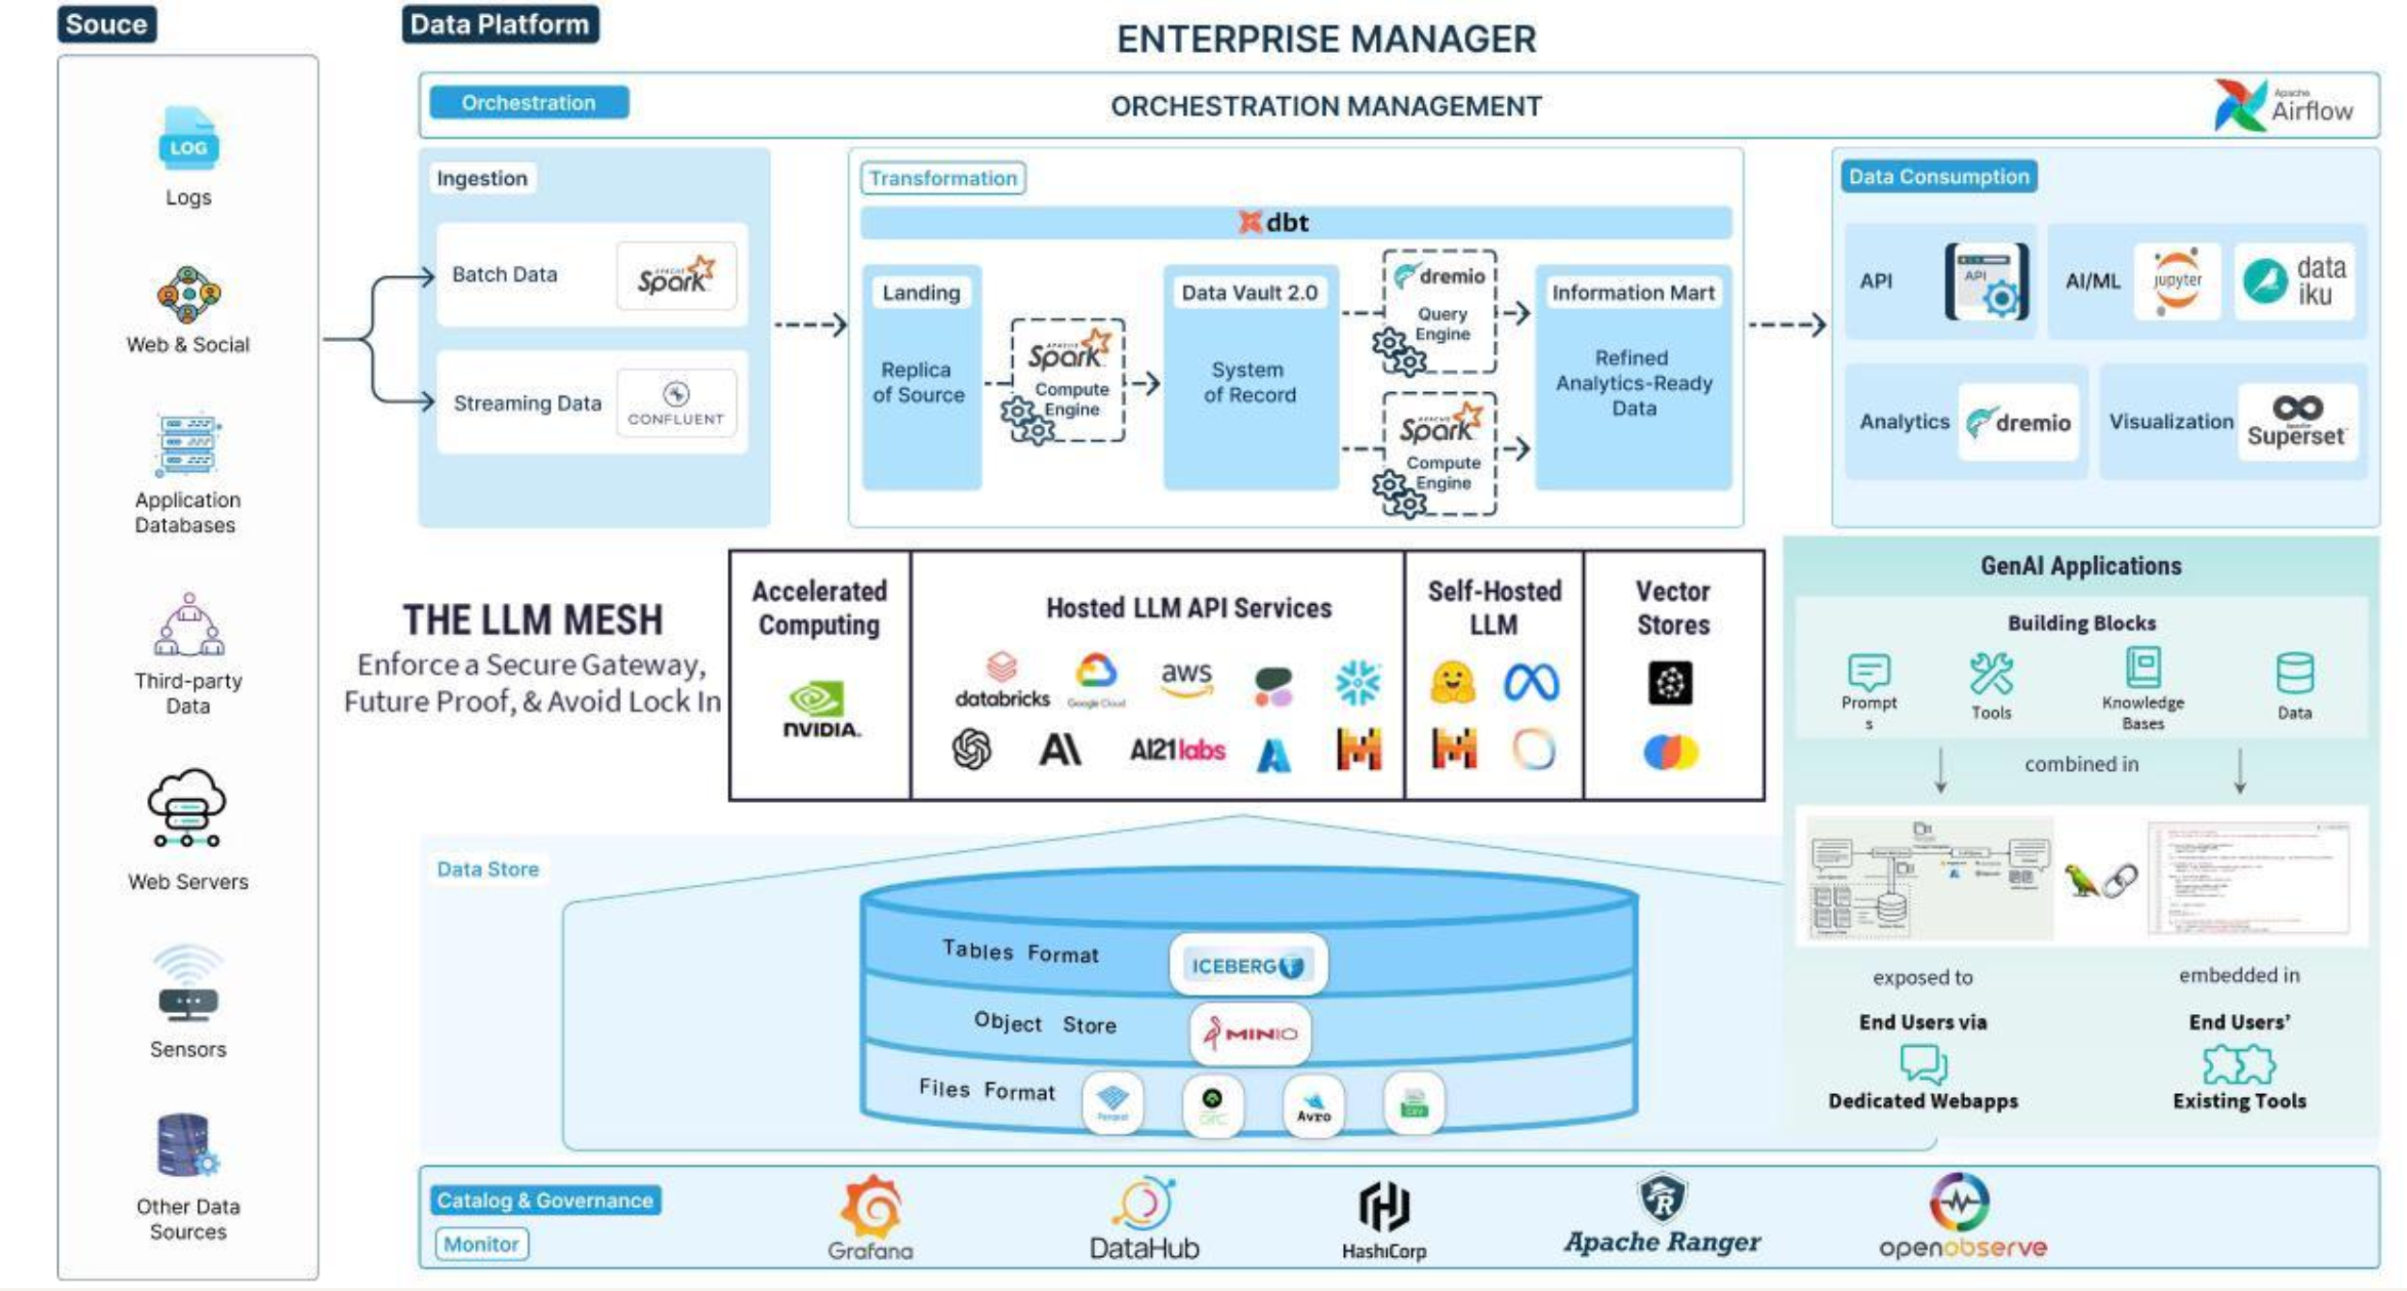
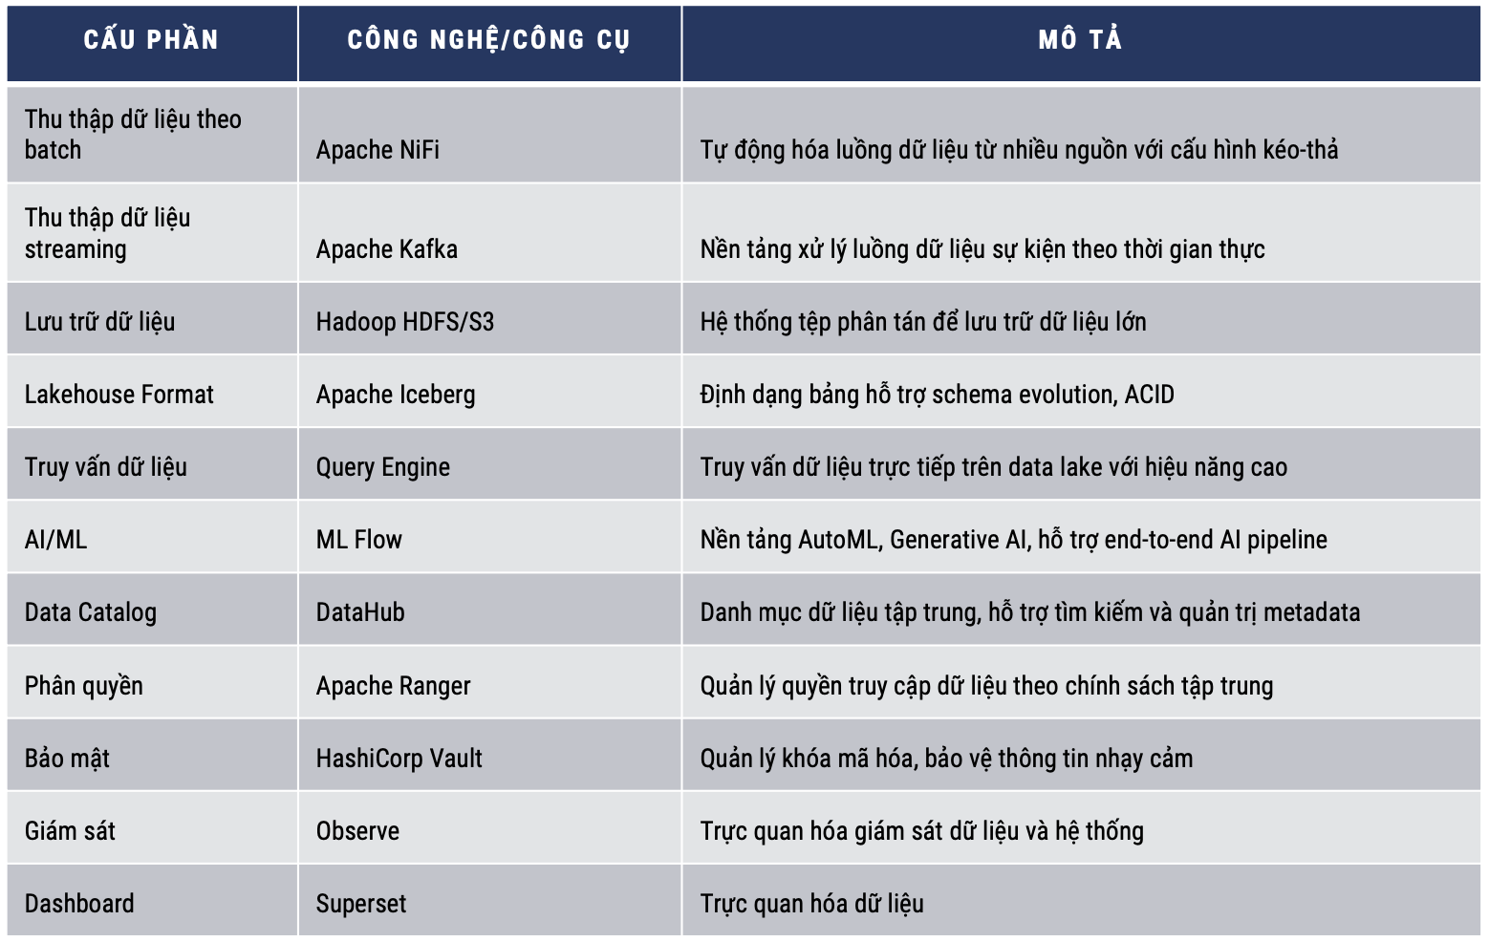
Business Partner Review
Katalyst – Overview
Proposed Architecture | Proposed Components
Notes:
1 hiện trạng
2 sizing
3 tiếp cận triển khai

Slide 14















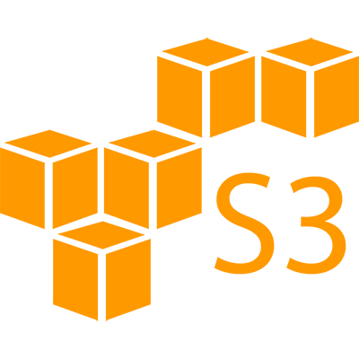
Business Partner Review
Katalyst – Component Mapping
Data Consumer
Data Producer
Data Operator
Self Service
Discover Data
Trust Data
Understand Data
Data Privacy
Self Service
Share Data
Update Data
Package Data
Data Privacy
Proactive Alert
Data Quality Remediate
Metadata Impact Analysis
Data Incident Management
Monitor Data
AI Governance
Advanced Analytic
AI/ML/Agentic AI
BI Report
Adhoc-Query
Data Consumption
Data Virtualization / Data Federation / Query Engine
Data Process
Data Observability
Data Management
Data Warehouse
Data Lake / GenAI DataStore
Data Quality
Structured Data Source
Structured Data Source
Structured Data Source
Un-Structured Data Source
Un-Structured Data Source
Un-Structured Data Source
Object Store / File Store
Data & AI Management
Data Organization
Data Integration
Notes:
1 hiện trạng
2 sizing
3 tiếp cận triển khai

Slide 15

Business Partner Review

Slide 16
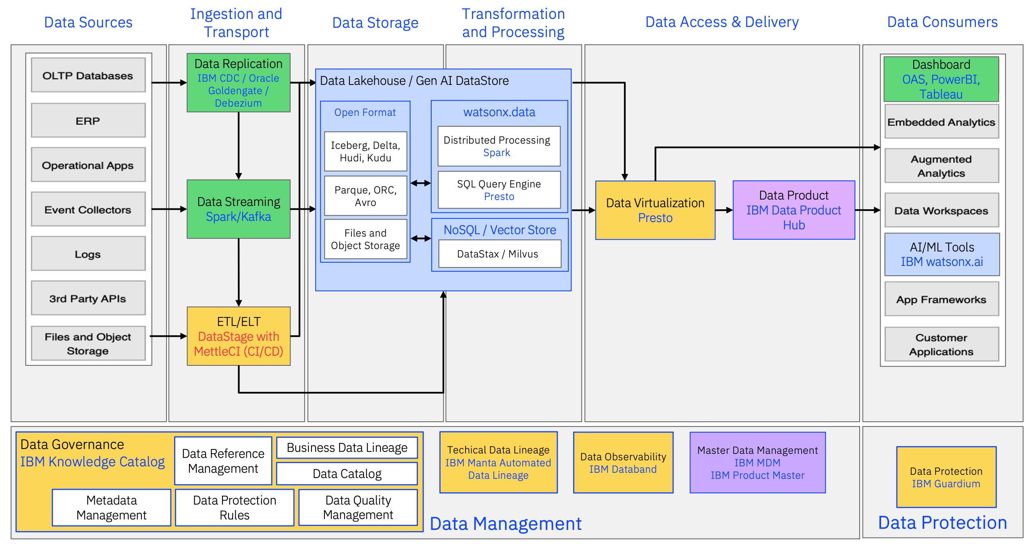
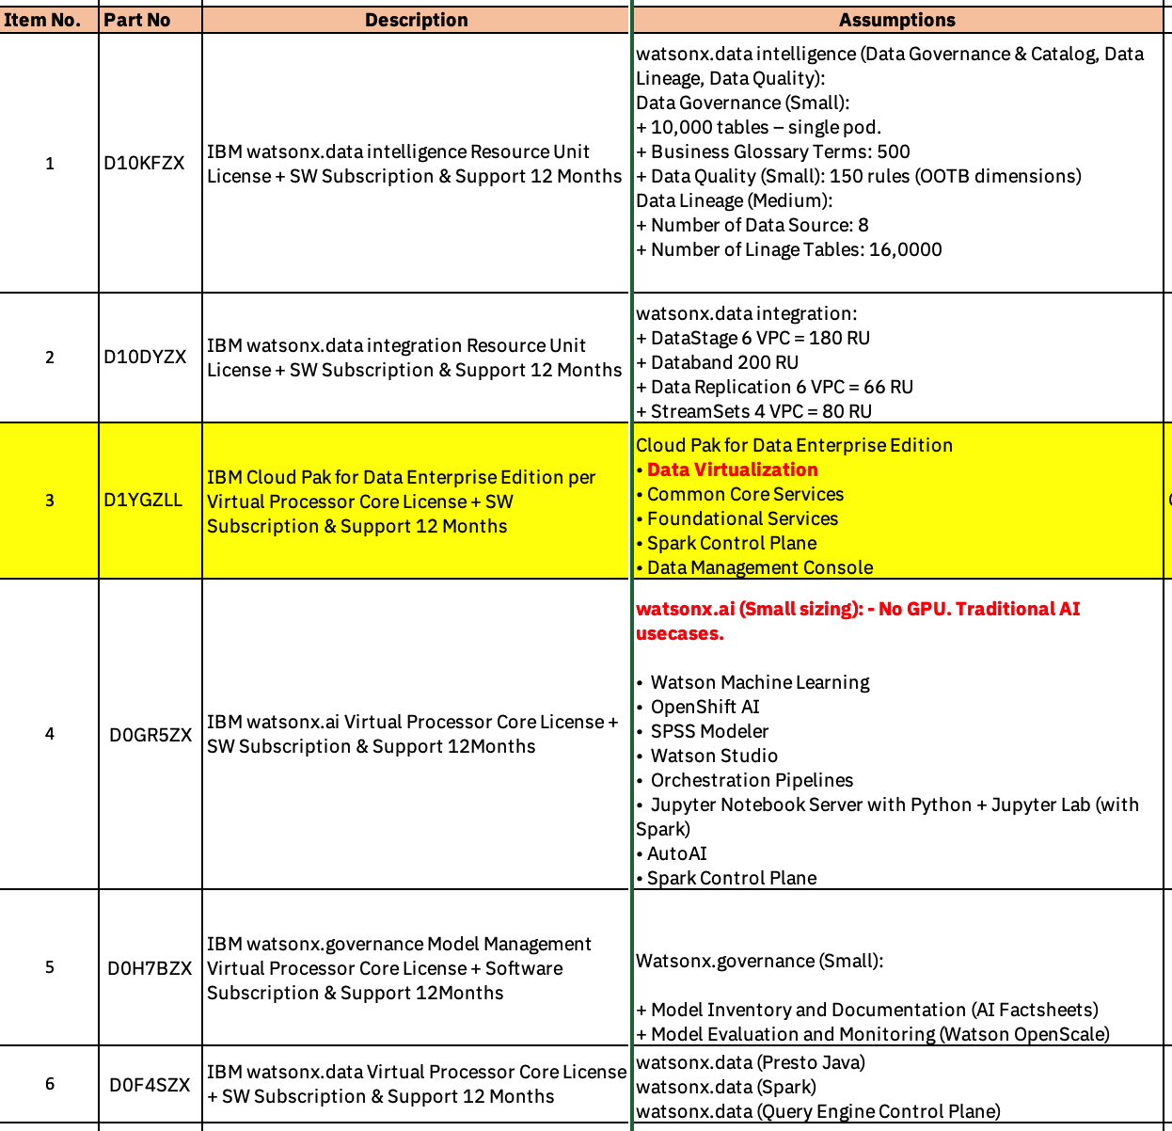
Business Partner Review
IBM – Overview
Proposed Architecture | Proposed Components
Notes:
1 hiện trạng
2 sizing
3 tiếp cận triển khai

Slide 17


Business Partner Review
IBM – Component Mapping
Data Consumer
Data Producer
Data Operator
Self Service
Discover Data
Trust Data
Understand Data
Data Privacy
Self Service
Share Data
Update Data
Package Data
Data Privacy
Proactive Alert
Data Quality Remediate
Metadata Impact Analysis
Data Incident Management
Monitor Data
AI Governance
Advanced Analytic
AI/ML/Agentic AI
BI Report
Adhoc-Query
Data Consumption
watsonx.governance
watsonx.ai
Data Virtualization / Data Federation / Query Engine
Data Process
Data Observability
Data Management
watsonx.data
watsonx.data
intelligence
Data Warehouse
Data Lake / GenAI DataStore
watsonx.data integration
Structured Data Source
Structured Data Source
Structured Data Source
Un-Structured Data Source
Un-Structured Data Source
Un-Structured Data Source
Object Store / File Store
Data & AI Management
Data Organization
Data Integration
Notes:
1 hiện trạng
2 sizing
3 tiếp cận triển khai

Slide 18

Business Partner Review

Slide 19
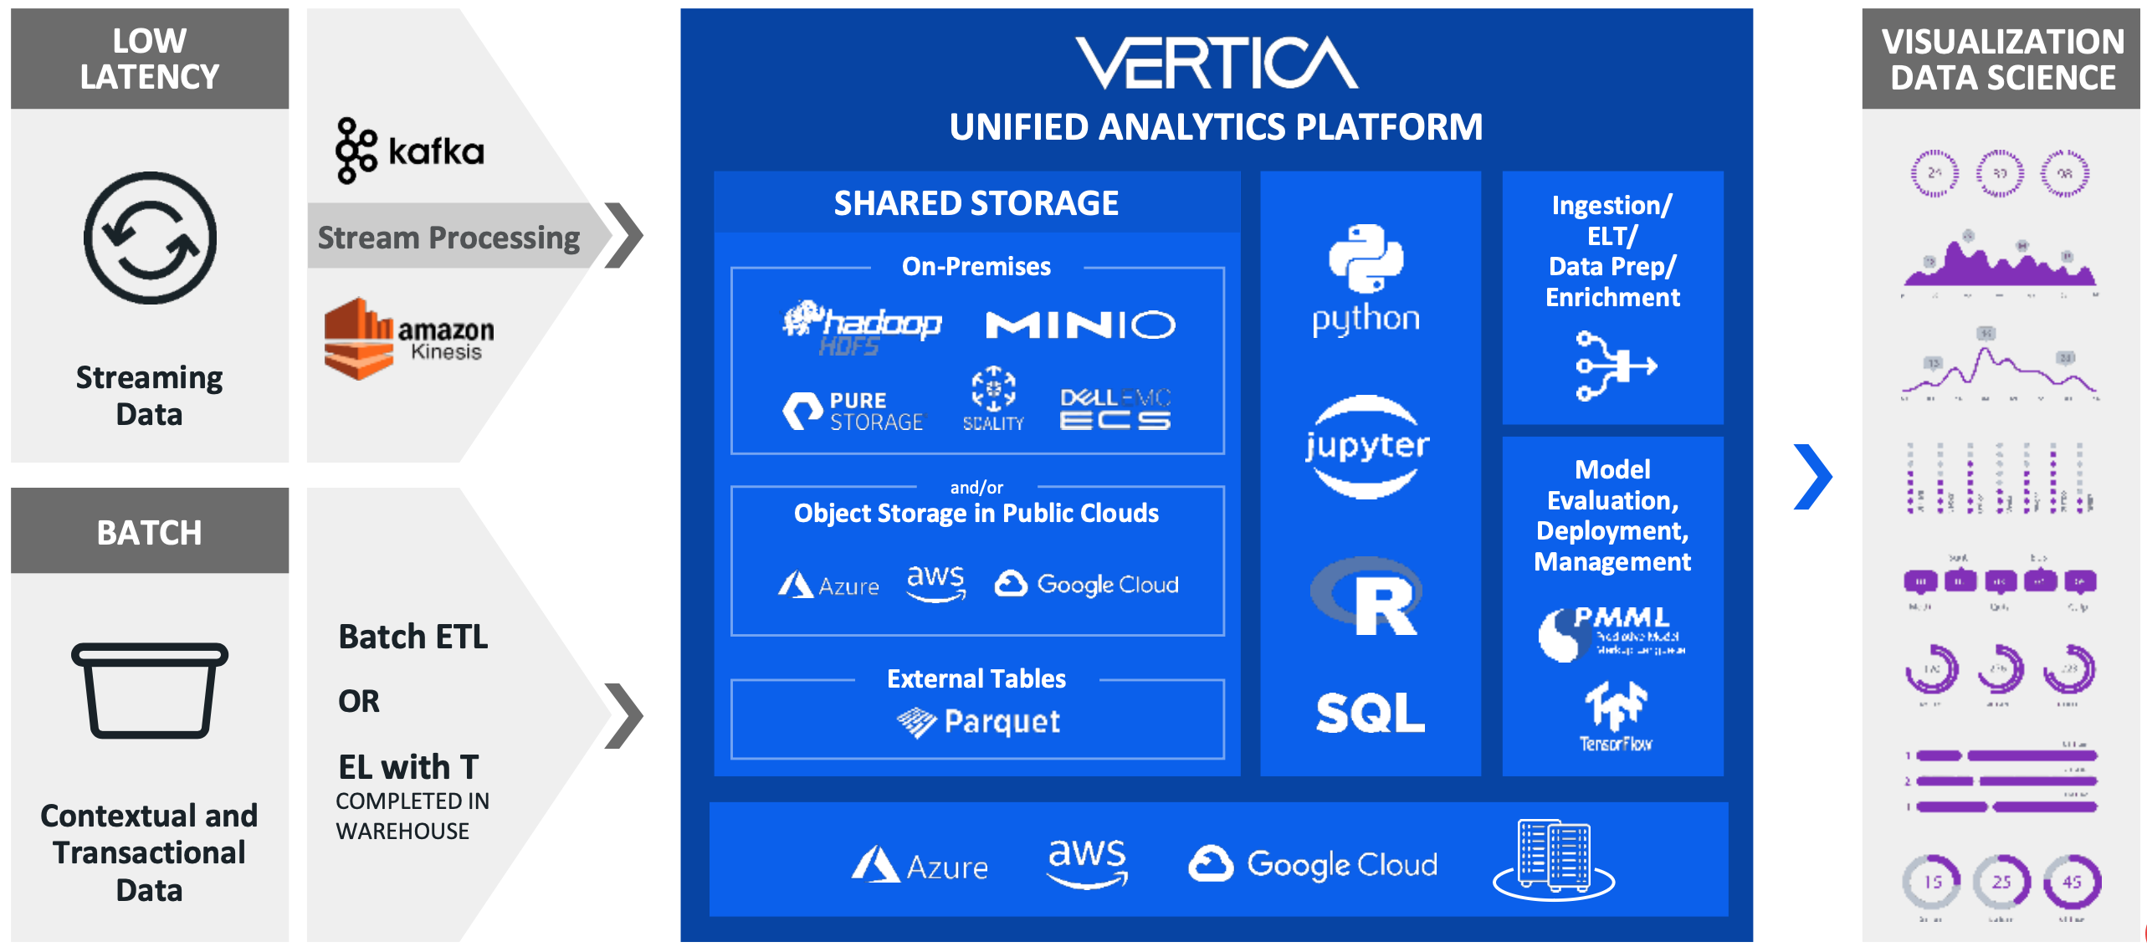
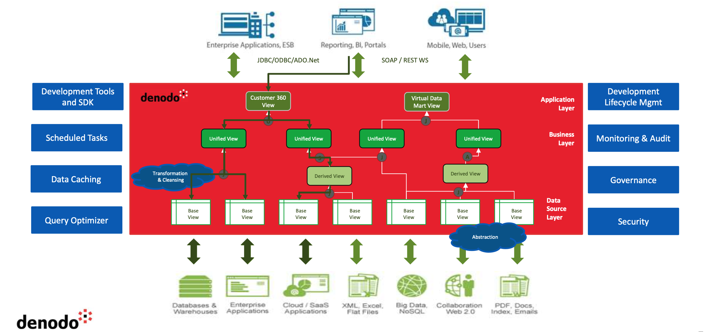
Business Partner Review
BNH – Overview
Proposed Architecture | Proposed Components
 | Data Virtualization High Performance RDBMS with built-in ML capabilities
Notes:
1 hiện trạng
2 sizing
3 tiếp cận triển khai

Slide 20


Business Partner Review
BNH – Component Mapping
Data Consumer
Data Producer
Data Operator
Self Service
Discover Data
Trust Data
Understand Data
Data Privacy
Self Service
Share Data
Update Data
Package Data
Data Privacy
Proactive Alert
Data Quality Remediate
Metadata Impact Analysis
Data Incident Management
Monitor Data
AI Governance
Advanced Analytic
AI/ML/Agentic AI
BI Report
Adhoc-Query
Data Consumption
Data Virtualization / Data Federation / Query Engine
Data Process
Data Observability
Data Management
Data Warehouse
Data Lake / GenAI DataStore
Structured Data Source
Structured Data Source
Structured Data Source
Un-Structured Data Source
Un-Structured Data Source
Un-Structured Data Source
Object Store / File Store
Data & AI Management
Data Organization
Data Integration
Notes:
1 hiện trạng
2 sizing
3 tiếp cận triển khai

Slide 21

Business Partner Review

Slide 22
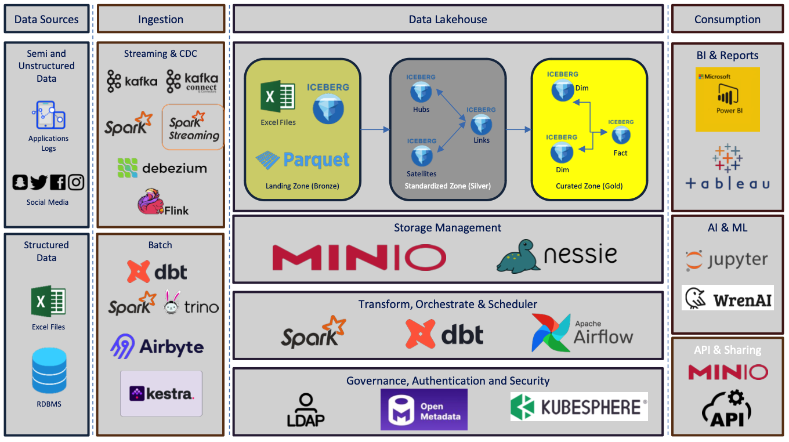
Business Partner Review
Raffles – Overview
Proposed Architecture | Proposed Components
Notes:
1 hiện trạng
2 sizing
3 tiếp cận triển khai

Slide 23

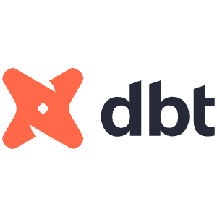


Business Partner Review
Raffles – Component Mapping
Data Consumer
Data Producer
Data Operator
Self Service
Discover Data
Trust Data
Understand Data
Data Privacy
Self Service
Share Data
Update Data
Package Data
Data Privacy
Proactive Alert
Data Quality Remediate
Metadata Impact Analysis
Data Incident Management
Monitor Data
AI Governance
Advanced Analytic
AI/ML/Agentic AI
BI Report
Adhoc-Query
Data Consumption
Data Virtualization / Data Federation / Query Engine
Data Process
Data Observability
Data Management
Data Warehouse
Data Lake / GenAI DataStore
Structured Data Source
Structured Data Source
Structured Data Source
Un-Structured Data Source
Un-Structured Data Source
Un-Structured Data Source
Object Store / File Store
Data & AI Management
Data Organization
Data Integration
Notes:
1 hiện trạng
2 sizing
3 tiếp cận triển khai

